Slide 1



Slide 2
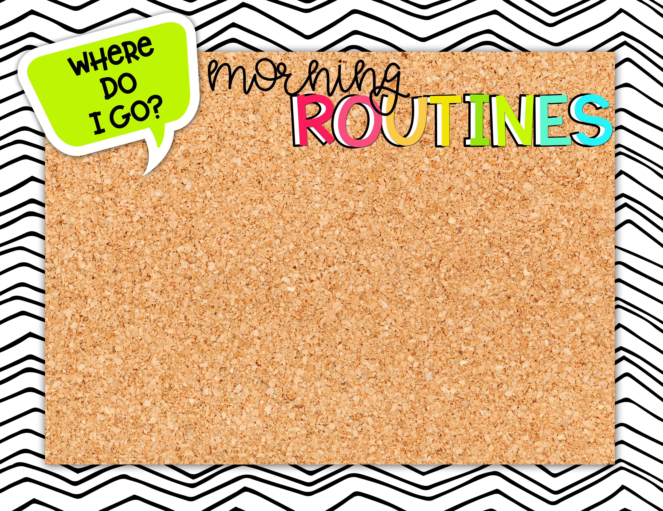

Students should arrive no earlier than 7:45 a.m. and will go to the cafeteria.
For the first 3 days of school, students will walk to our classroom, beginning at 8:00 a.m. On Monday, August 16th, students will go to the intermediate playground from 8:00 – 8:25.
The first bell will ring at 8:25 a.m. to start our day.

Slide 3
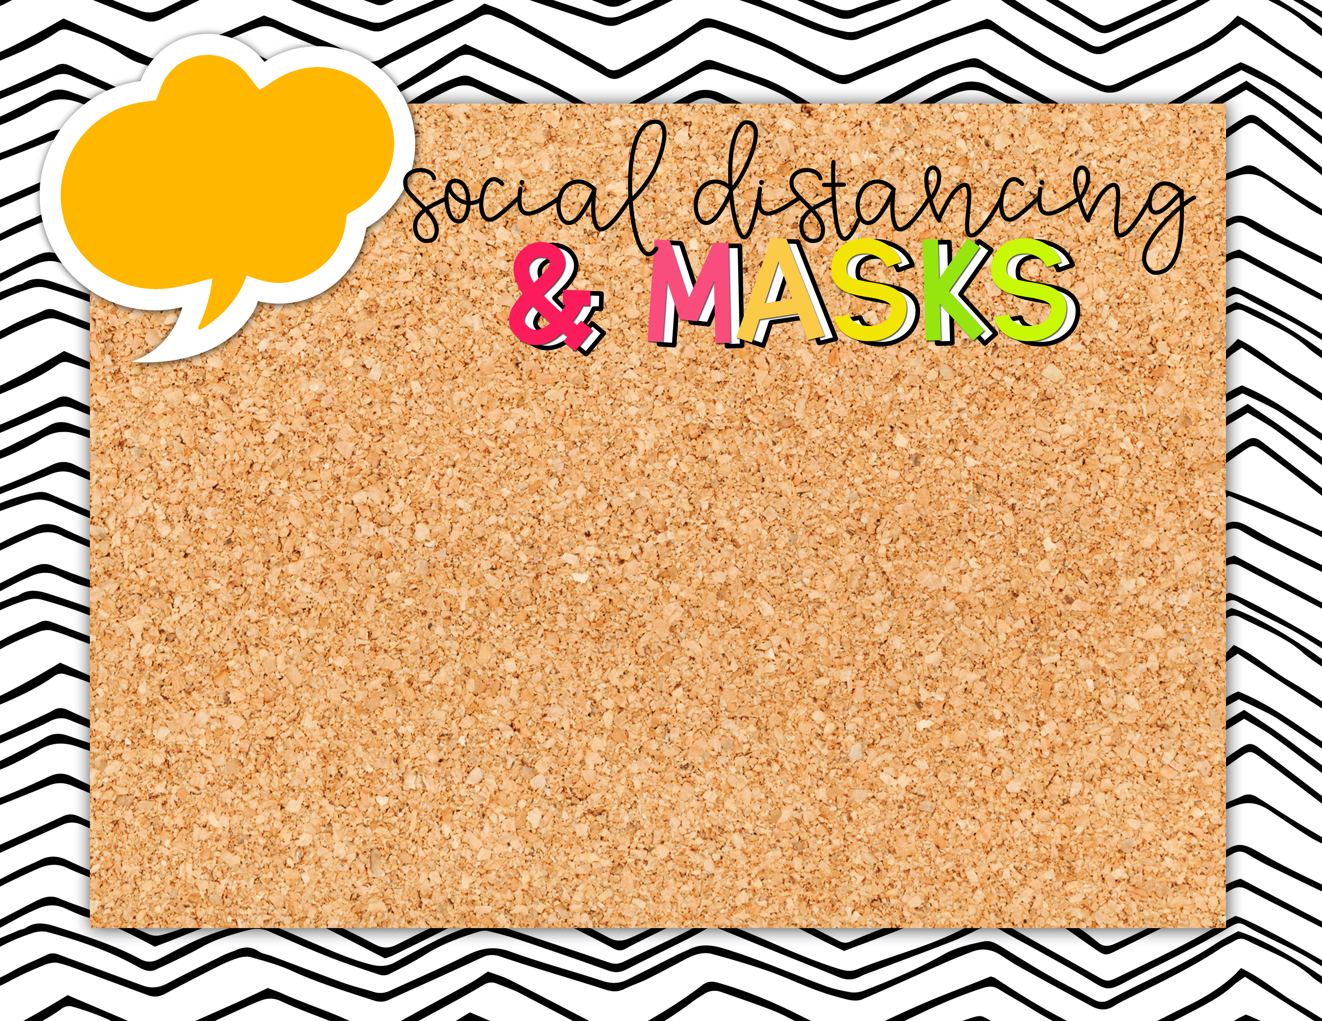
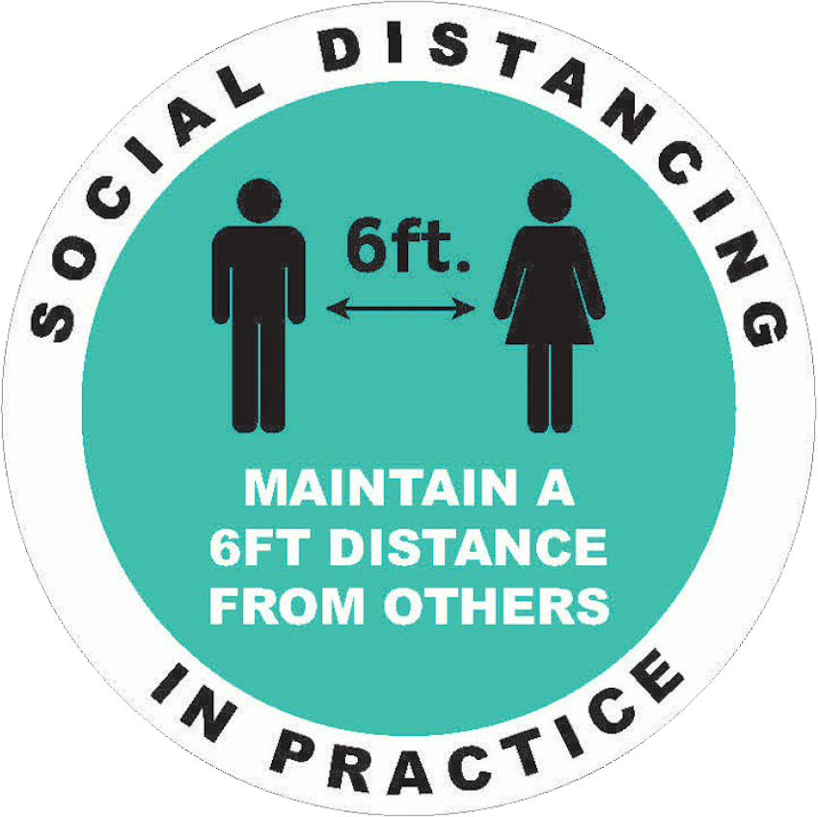
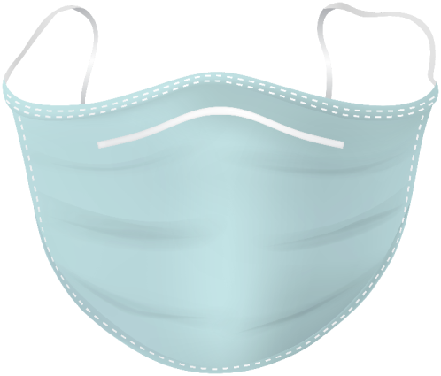
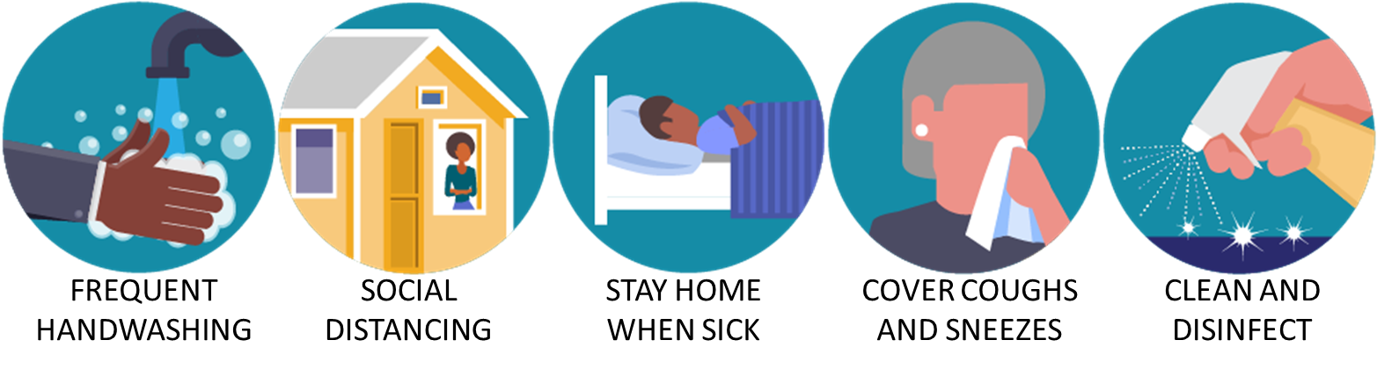
In the classroom and around school, we will practice social distancing (6 feet apart).
As of today, August 16th, masks are optional; however they are strongly encouraged.
Please review the procedures below to help your child as they adjust back to school.

Slide 4


Lunch Time
1:04-1:29
Please send a snack with your child each day. We will have a morning snack time.
Students who choose to eat a school lunch will receive a FREE lunch each day.
There will be NO lunch bunch.

Slide 5


Students will wait in the classrooms to be dismissed at the end of the day. When you arrive at the arrival sign at car pick up, you will announce your arrival via the Pik My Kid app. Your child will be dismissed at that time and will head to the car pick up area. In the Pik My Kid app, you can designate how your child goes home.
If you will be picking your child up at the front of the school (formally known as bike rack, now called GATE pickup), please meet your child outside of the black gate at the third grade building.

